Slide 1
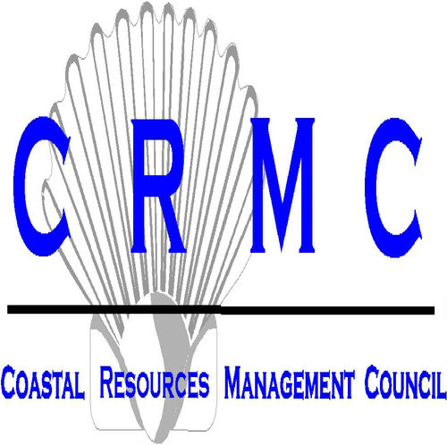
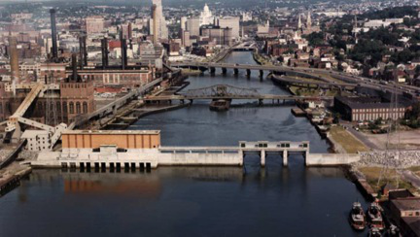
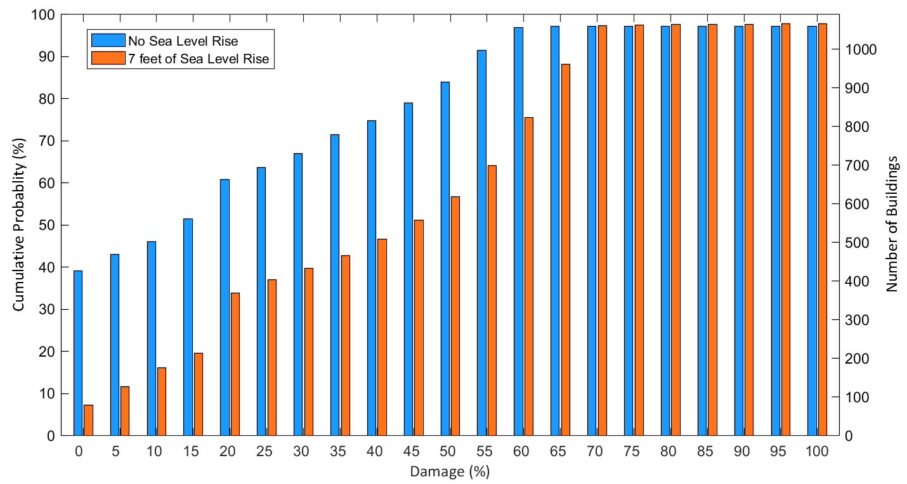
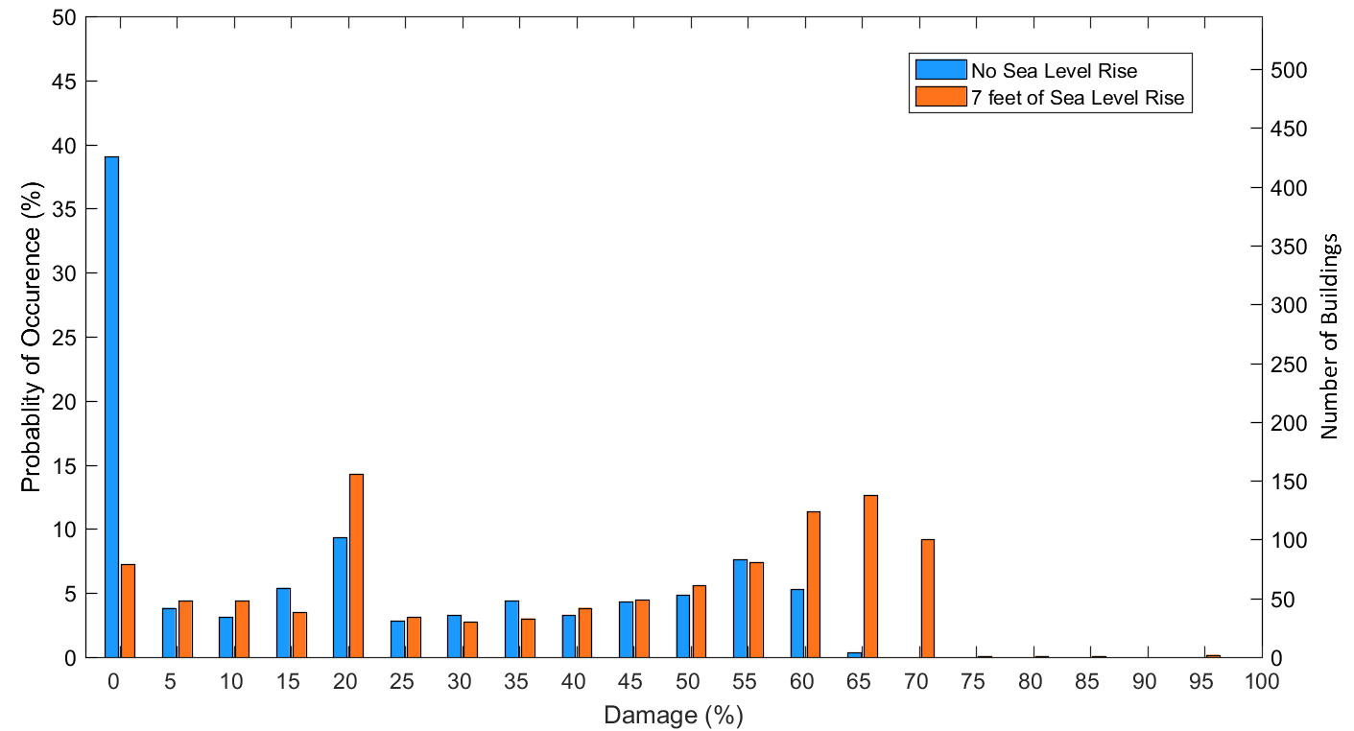
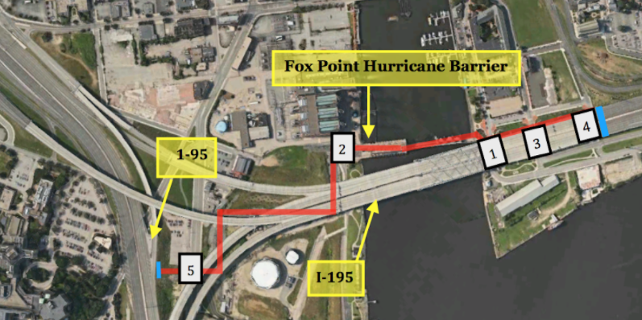
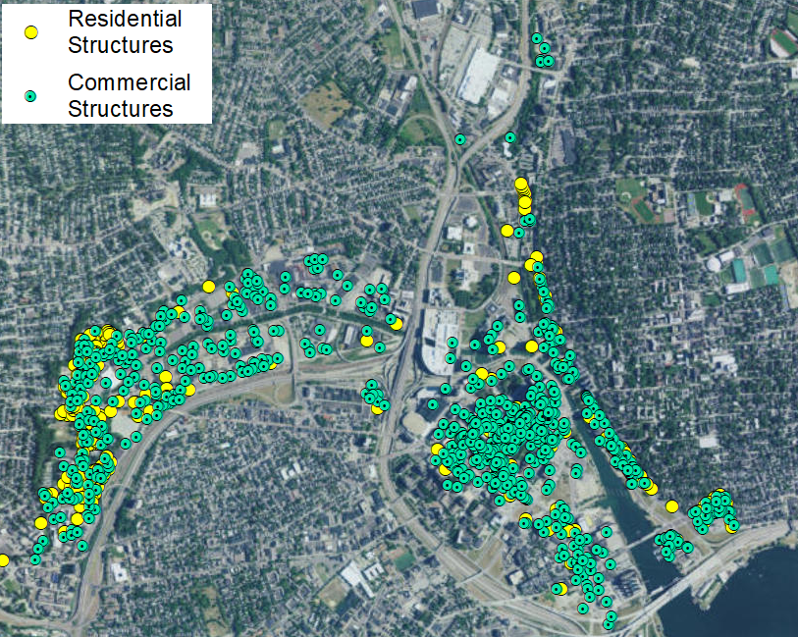
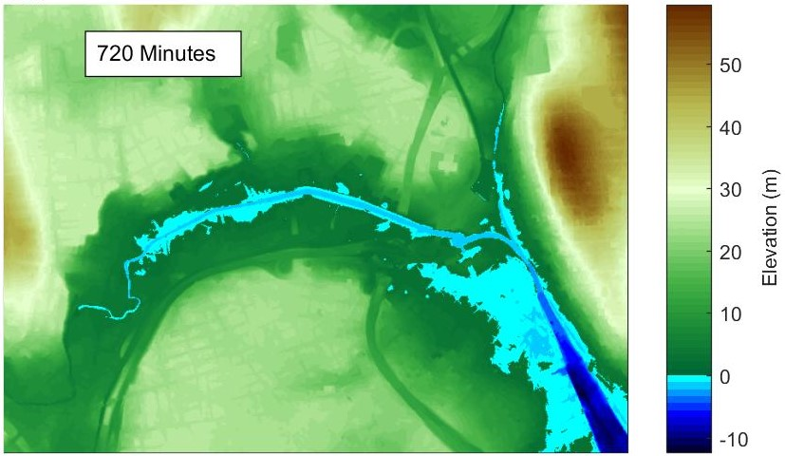
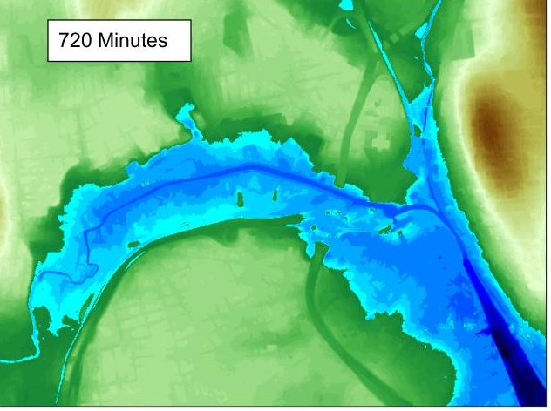
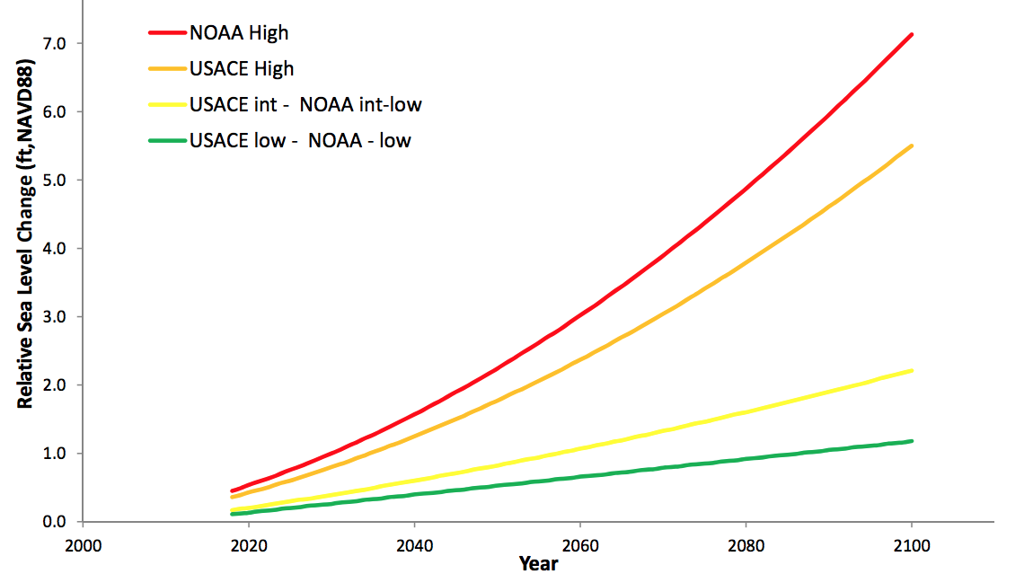
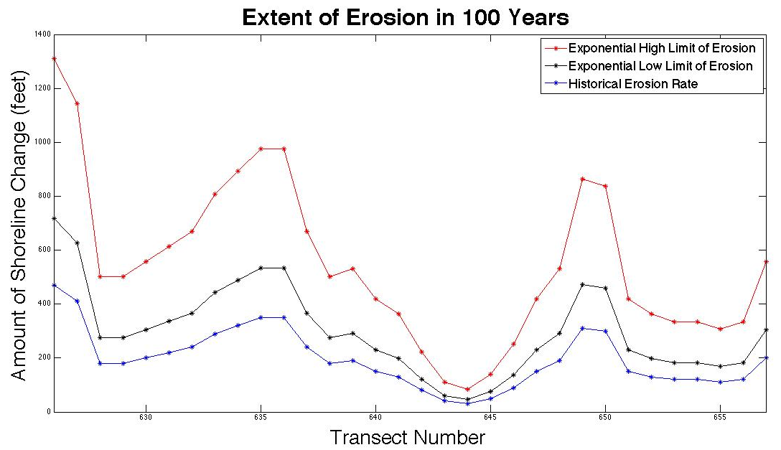
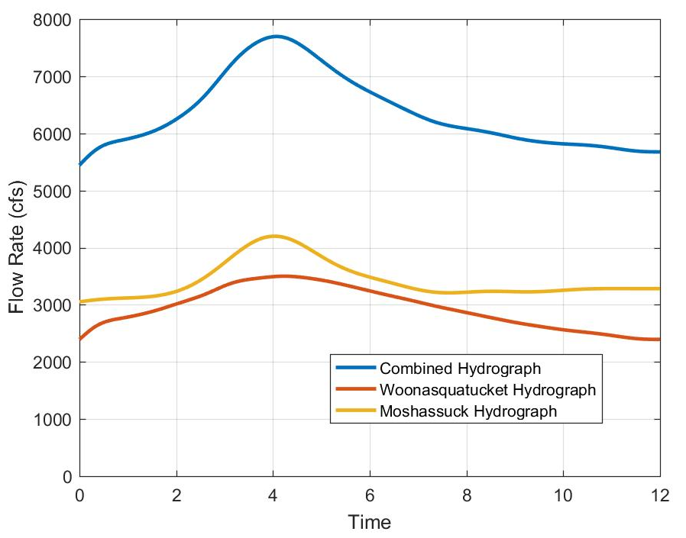
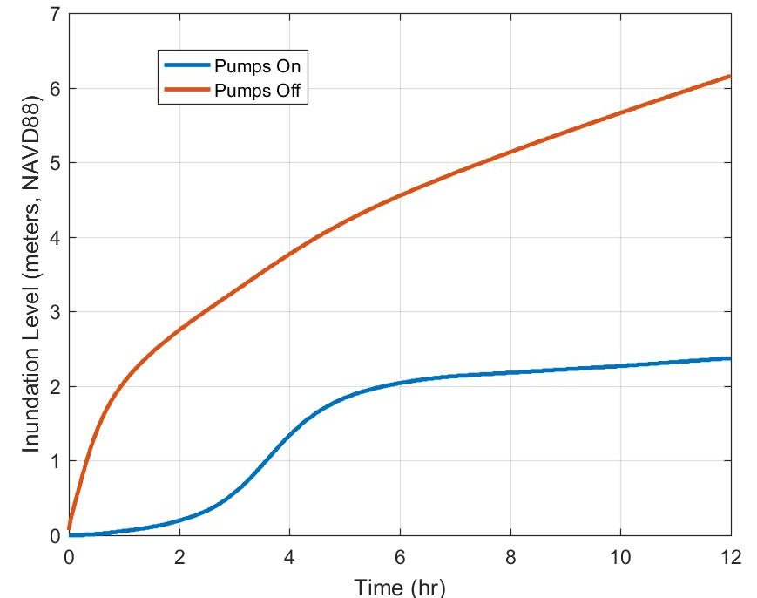
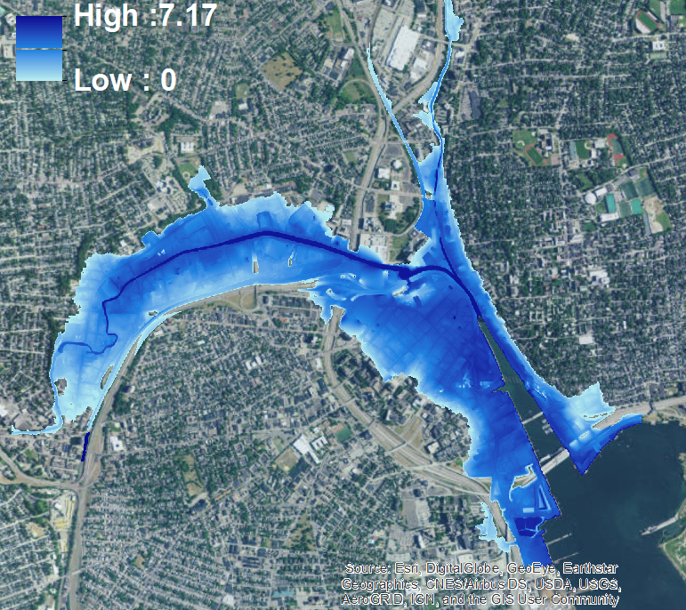
Application of the Coastal Environmental Risk Index (CERI) to Providence and the Fox Point Hurricane Barrier
M. Auidi¹, E.Day¹, P. Girard¹, N. Menefee¹, M. Schwarz¹, E. Zarba¹, M. Spaulding², C. Baxter³, C. Swanson⁴
¹Student, Department of Ocean Engineering, University of Rhode Island, Narragansett, RI. ² Professor Emeritus, Department of Ocean Engineering, University of Rhode Island, Narragansett, Rhode Island.
³ Professor, Department of Ocean/Civil and Environmental Engineering, University of Rhode Island, Narragansett, Rhode Island ⁴Swanson Enviromental Associates LLC, Saunderstown, RI
Abstract
Methodology
Providence, Rhode Island, is a densely populated city that is susceptible to coastal flooding. The Hurricane of 1938 and Hurricane Carol (1954) significantly flooded the downtown area leading to the construction of the Fox Point Hurricane Barrier from 1960-1966. Due to increasing sea level rise and future storm intensity the reliability of the barrier is in question. The objective of the study is to assess flooding damage to structures in Providence using the Coastal Environmental Risk Index (CERI) for a 100-year storm, including 7 feet of sea level rise. CERI requires inputs of storm surge, waves, and structural data pertaining to location and first floor elevation. The results from CERI without the Hurricane Barrier operational show damage dominating from inundation. The 100-year storm without sea level rise would damage 664 structures; with 7 feet of sea level rise the same storm would damage 1008 structures. Continued analysis is being performed for fluvial flooding from the Moshassuck and Woonasquatucket Rivers as well as potential overtopping of the barrier from storm surge. The permeability and possible settlement is also being considered following a Real Time Kinematic survey of the barrier.
STORMTOOLS Storm Water Level and Waves (100yr, with and without SLR)
Fox Point Hurricane Barrier
Structure Prototype and First Floor Elevation
Inundation and Wave Damage Functions by Structure Type
CERI
Estimated Damage
Damage by Individual Structure
CDF
PDF
Figure 10: Image of the Fox Point Hurricane Barrier
Why Providence?
Figure 1: Distribution of residential Figure 2: Flooding in downtown Providence as
and commercial structures in the a result of the Hurricane of ‘38 (left) and
study area. (ArcGIS). Hurricane Carol (right).
Providence has a history of intense flooding in its structurally dense and highly commercialized downtown area. With the addition of sea level rise, Providence could be majorly affected by a large scale storm.
The Coastal Environmental Risk Index (CERI) provides a summary of the risk coastal areas face from the environment; specifically storm included flooding and the associated wave environment, sea level rise, and shoreline erosion/accretion.
Figure 11: The barrier includes an east and west wing wall and 5 vehicular gates
Constructed in 1960 after Providence suffered serious damage from The Hurricane of ‘38 and Hurricane Carol (1954)
Built to stand 23.9 feet above NAVD 88
Contains a pump house with 5 high capacity pumps
NACCS Damage Functions
Fluvial Flooding
Pumps On
Pumps Off
Sea Level Rise (SLR)
South Kingstown Beach Western Boundary of Study Area (626)
Three Story Apartment (1A-3)
Tara’s Pub (635)
Low Lying Area with an Inland Pond (649)
Eastern Boundary of Study Area (657)
Commercial Engineered (2)
Westernmost Revetment (628)
Commercial Non/Pre Engineered(3)
Urban High Rise (4A)
Beach Area West of the Ocean Mist with low impact waves (644)
Single Story Residential w/o Basement (5A)
Two Story Residential w/o Basement (5B)
Two Story Residential w/o Basement(5B)
Figure 12: Flooding of downtown Providence due to river overflow from the Woonasquatucket and Moshassuck Rivers with the Fox Point Hurricane Barrier Closed.
Single Story Residential w/ Basement (6A)
Two Story Residential w/ Basement(6B)
Hydrograph
Inundation Levels
Figure 6: Created in ArcGIS displays the location of each prototype in the study area.
Figure 7: Depicts examples of the four most abundant structures in the project area
⁶North Atlantic Coast Comprehensive Study conducted by the US Army Corps of Engineers
http://www.corpsclimate.us/ccaceslcurves.cfm
Estimated Damage
Figure 8: Individual structure damage amount of damage that Figure 9: Individual structure damage amount of damage that would most likely occur from a 100 year storm without sea level rise. would most likely occur from a 100 year storm with 7 feet of sea level rise.
For a 100 year storm event with no sea level rise, as shown in Figure 8 above on the left, 664 structures receive damage.
For a 100 year storm event with 7 feet of sea level rise, as shown in Figure 9 above on the right, 1008 structures receive damage.
This means with the added 7 feet of sea level rise # more structures were affected, which corresponds to a 52% increase in the amount of structures that experience damage from the 100 year storm.
These results demonstrate the dramatic impact sea level rise will have on Providence, if the barrier is ineffective
Figure 3: Regionally corrected sea level rise predictions for Newport, RI from NOAA and the USACE.
STORMTOOLS and STWAVE
Figure 13: Hydrograph and corresponding inundation levels with the pumps on and off of the Providence area. Peak flows rates were determined from the 100-year return rate reported in the Providence County Flood Insurance Study (2012).
Conclusion
This study shows that the Providence area would receive significant damage without the hurricane barrier in operation. Using the NACCS damage functions, damage estimates were made for each structure in the study area from a 100 year storm with and without sea level rise. These results, and the CERI methodology can be used by homeowners to evaluate the risk to their homes and by community planners to evaluate mitigation strategies.
Figure 4: STORMTOOLS flood layer for 100 year storm with 7 feet of sea level rise.
Figure 5: STWAVE model for 100 year storm with 7 feet of sea level rise.
STORMTOOLS flood layers were used to determine the inundation depth in feet at each structure in the study area.
STWAVE model outputs significant wave heights (Hs).
Significant wave heights were then converted into wave crest heights (Hc) using the equation Hc = 1.12Hs.
The wave crest heights were found at each structure in the area.
Waves were an insignificant source of damage relative to inundation.
References
The authors would like to acknowledge Chris Damon of the RI CRMC and Dr. Annette Grilli of the University of Rhode Island for help with the STWAVE analyses and programming of CERI.

